Slide 1
Castle chęciny

Slide 2
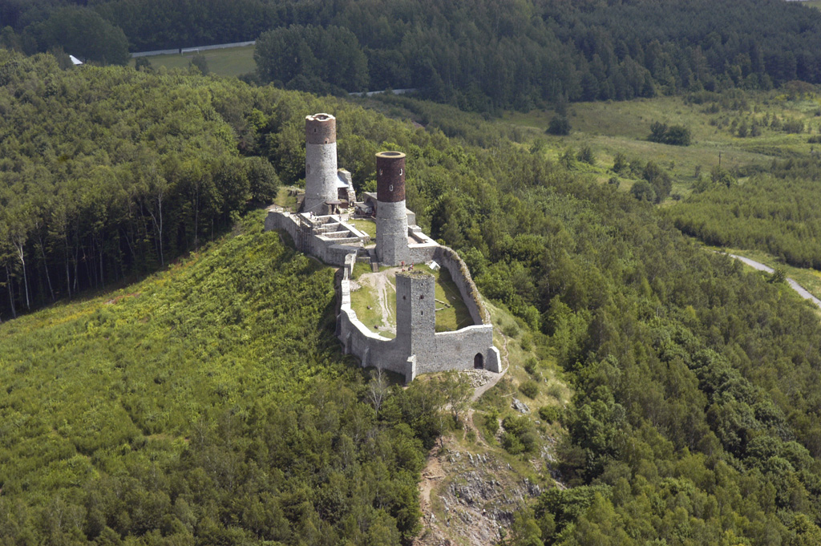
Chęcinach Castle - the royal castle at the turn of the thirteenth and fourteenth centuries, towering above the village Chęciny, in the Kielce Voivodship.

Slide 3
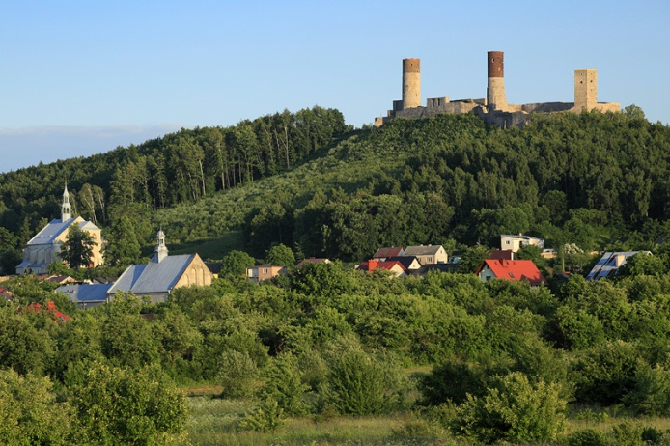
Checinski castle is situated on a big hill, where there are trees and meadows.

Slide 4
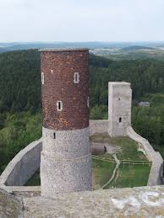
Are in the strongholds, therre great faith and well.

Slide 5
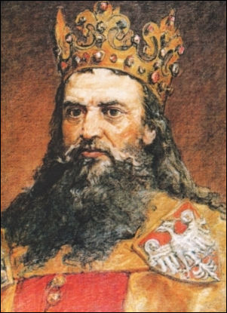
Chęciny Castle is a very interesting place. It was built by King Casimir the Great.

